Slide 1

WELCOME TO CFG
YOUR INTRODUCTION TO
DATABASES & SQL PROGRAMMING LANGUAGE
TECH OPENS UP LIMITLESS OPPORTUNITIES FOR GIRLS
Notes:
1] Welcome students onto the course and introduce CFG! Our mission, why we do what we do and encourage them to share their experience on the course with others.

Slide 2





COURSE JOURNEY
Database design & data visualisation
MOCK PROJECT
FINAL PROJECTt presentations and mock interviews
Database design and data visualisation
MODULE 7
MODULE 8
MODULE 7
Data management using SQL coding techniques
MODULE 6
Data manipulation with SQL programming language
Data analysis for complex structures
MODULE 5
MODULE 4
Data analysis
MODULE 3
Introduction to SQL programming language and Data Science
SQL coding and Database management technique
MODULE 1
MODULE 2

Slide 3
MODULE 1: HTML
DB DESIGN AND
DATA VISUALISATION
DB backup and restore
DD data import and export
MOCK PROJECT: DB design and data visualisation
07

Slide 4



PERFECT WORLD

Slide 5


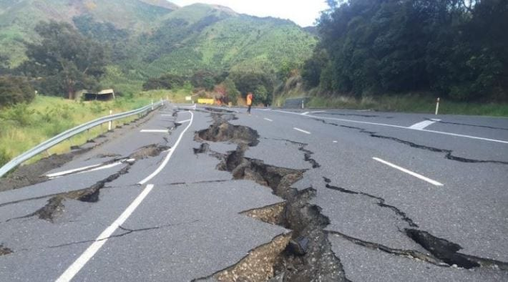
DISASTER STRIKES

Slide 6

I need to audit an old DB!
I spilled coffee on my laptop, it is dead!
I have a backup, but it does not restore!
I accidently dropped DB table!
REAL LIFE SCENARIOS

Slide 7
We can back up one database or multiple ones at the same time.
We can also back up a single table from a database
We can back up not just the database with its tables, but also the logic encapsulated in Triggers, Stored Procedures etc.
We are going to use CMD (Linux command line widow) in order to perform the backup.
MYSQLDUMP

Slide 8





SCENARIO
SET UP
Notes:
We are a very successful bakery business with a chain of shops in the UK and France. Already sounds brilliant, doesn’t it?
Our Headquarters are in French Paris and our second branch office is located in London.
Shops in Paris and London are run as two separate business units, i.e. have two designated databases for each shops.
Databases contain information about our customers, orders they placed, all products that we produce, all ingredients that we have in stock in order to bake our delicious cakes, but also information about prices and sales figures.
We also have two DBAs (Database Administrator – a very important and ‘in-demand’ role) Pierre in Paris and Margaret in London who look after and manage our database.

Slide 9

INSTRUCTOR DEMO
Every month both London and Paris bakeries have to analyse end of month sales and pay the franchisee royalties to the Bakery brand in France.
Pierre gets in touch with Margaret and asks her to take a backup of the London bakery database that captures all activates including sales figures and send it over to him.
Task
Take a backup of a single database
Store it in a new folder
Notes:
When we installed MySQL Server, we automatically installed mysqldump file.
All we need to do now is to find where it is on our machine. We are looking for mysqldump.exe
It will be a part of the MySQL Server package, so let’s find the relevant MySQL Server folder first. For example, it may be stored somewhere in your Program Files:
C:\Program Files\MySQL\MySQL Server 8.0
Once we have located the correct folder, we need to find the mysqldump executable. Most likely, it would be ‘hiding’ in the bin subfolder. Double check that you found it.
Now let’s open the CMD window and change directory to the folder where mysqldump.exe is located (your instructor would explain the steps and ‘change directory command’)
Now we are ready to do our backup and recovery practice!
NB: there is answer sheet with the DB backup code in the instructors section.

Slide 10


WIDOWS
SELF-STUDY TASK
MAC
Watch the videos for MAC and WINDOWS on how to back up a database.
There are multiple scenarios in the reference material section – they offer you a challenge to try to back up multiple tables withing one DB or even multiple DBs
Review and complete those study cases on DB backup.
STUDY VIDEOS ABOUT DB BACKUP
Practice case study scenarios on DB backup, review additional materials
On internet if necessary.
Notes:
Video for Windows. (not cmd, but directly through MySQL command line) https://www.youtube.com/watch?v=tpAk7Kveig4
how to backup a DB on Mac --> please review: https://www.youtube.com/watch?v=2-_ZU7N3XEM

Slide 11
A successful restore is equally valuable as a successful backup
A disaster recovery strategy is never complete without a test of a database restore.
Always test your backup by restoring it on a test server or another machine
DATABASE RESTORE

Slide 12
SYNTAX
EXAMPLE
mysqldump options > backup_filename.sql
Mysql options < backup_filename.sql
CREATING BACKUP
RESTORING BACKUP

Slide 13
INSTRUCTOR DEMO
Every month both London and Paris bakeries have to analyse end of month sales and pay the franchisee royalties to the Bakery brand in France.
Pierre gets in touch with Margaret and asks her to take a backup of the London bakery database that captures all activates including sales figures and send it over to him.
Upon receiving the backup Pierre needs to restore the database on a server.
Task
Restore a single database
Store it in a new folder
Notes:
See the answer code in the module sheet.

Slide 14

QUICK SUMMARY
mysqldump is a client utility that performs a logical backup
user can take backup of a database, a table, a schema, any stored routines and various other objects with the help of mysqldump
mysql is a client utility that restored a logical backup
mysqldump is useful for taking a backup, whilst mysql command is useful to restore the backup

Slide 15
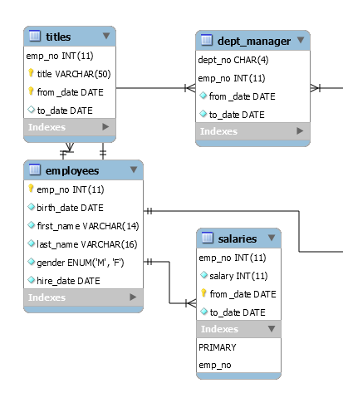
We can create a diagram for existing MySQL DB with the help of MySQL Workbench
It can be achieved by using the reverse engineering functionality to create a model.
ER DIAGRAM

Slide 16
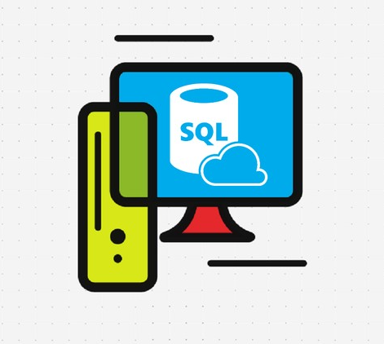
MOCK PROJECT
Create and design a brand new DB
Upload data from a csv file into a new DB
Build an ER DIAGRAM for the new DB
Write queries to select required sample data
Export data into a new csv file
Visualise resulting data set with Tableau
Notes:
LET’S COMPLETE THE MOCK PROJECT TOGETHER FROM SCRATCH – see step by step mock project guidelines.

Slide 17

PROJECT
The project is an essential part of his course. In order to ‘graduate’ and get a certificate of completion you need to create, deliver and present your own database project. Your project should reflect all major learning outcomes from the course modules. There are ‘must have’ core requirements, that need to be achieved as a minimum deliverable.
CORE REQUIREMENTS
Create relational DB of your choice with minimum 5 tables
Set Primary and Foreign Key constraints to create relations between the tables
Using any type of the joins create a view that combines multiple tables in a logical way
In your database, create a stored function that can be applied to a query in your DB
Prepare an example query with a subquery to demonstrate how to extract data from your DB for analysis
Create DB diagram where all table relations are shown

Slide 18
PROJECT
In addition to the core requirements you need to include any 2-3 requirements from the advanced options list. (Optionally, you can include more or all of the advance options, the ‘extras’ are entirely up to you. Although they do provide a very good learning ground). Everything outlined in the core and advanced lists have been covered in this course. You can vary your level of the project complexity by tuning the amount of stored objects, analytical filters and function, as well as amount of tables and their relations in the database.
ADVANCED OPTIONS
In your database, create a stored procedure and demonstrate how it runs
In your database, create a trigger and demonstrate how it runs
In your database, create an event and demonstrate how it runs
Create a view that uses at least 3-4 base tables; prepare and demonstrate a query that uses the view to produce a logically arranged result set for analysis.
Prepare an example query with group by and having to demonstrate how to extract data from your DB for analysis

Slide 19
PROJECT
PROJECT SUBMISSION AND ASSESSMENT
Take a backup copy of your diagram, save it as projectname.sql file and submit via Slack channel before the deadline.
Your instructor(s) would restore the file on their MySQL server and examine the code.
Your instructors would mark it accordingly, then provide comments and feedback on your project.
A copy of your project file along with the assessment and comments would be forwarded to CFG to keep a record of and to issue you a certificate, upon successful completion of the project.
Every student will be presenting and demonstrating their projects in class during week 8. To summarise, you need to do both: present the project in class and submit it online.

Slide 20
PROJECT
PROJECT PRESENTATIONS
Please note that it is possible to be working on a project in groups of two. In this case you can join forces with your classmate and work on the same DB. In this case you would need to take a number of backups and send the updates to each other or store a master copy of the DB on the cloud location e.g. Google Drive.
NB: if you do a group work , you are expected to do all advanced points and produce at least 8 tables in the DB.
You will have approximately 3 min to do a presentation in class. Start with the DB diagram and explain the idea behind your project, what it is for and how it is expected to be used.
The run your sample queries to demonstrate how functions, store procedures etc. work. Also show the class few snippets of sample data stored in tables.
A quick Q&A about the project at the end of each presentation from your instructors and the group.

Slide 21

HOMEWORK
Please work on your course projects to be ready to be presented during our class in week 8.
Please submit your projects online before the deadline.
GOOD LUCK!

Slide 22
THANK YOU
HAVE A GREAT WEEK!

Slide 23



REFERENCE
MATERIALS

Slide 24

POINTS TO REMEMBER
BACKUP =
DATA SAFETY
FREQUENT BACKUP AT REGULAR INTERVAL
STORE A BACKUP LOCALLY, CLOUD, REMOTE SERVERS!
SCHEDULE NIGHTLY MAINTENANCE PROCESS (BACKUP)
USE GOOGLE DRIVE, DROPBOX, REMOTE COMPUTERS (FTP)
UTILISE EXPORT & IMPORT FEATURES OF WORKBENCH
RESTORE DB WITH MYSQL
BACKUP DB WITH MYSQLDUMP

Slide 25

PRACTICE (optional)
Task No2
Every month both London and Paris bakeries have to analyse end of month sales and pay the franchisee royalties to the Bakery brand in France.
In addition to that, the management team in HQ in France wants to review employees records in London in order to analyse their performance, potentially promote few members of stuff and calculate end-of-year inflation based salary increases.
Pierre gets in touch with Margaret and asks her to take a backup of the London bakery database and London company (employee) database
Take a backup of multiple databases ( two different independent DBs)
Store everything in your backup folder

Slide 26
PRACTICE (optional)
Task No3
Once every quarter a full backup of all databases across all shops needs to be done, so it can be stored and archived in one single location. This is needed for the data security and audit purposes.
A full backup of EVERYTHING , i.e. all databases across all sights needs to be performed.
Take a backup of EVERYTHING – all databases from all location.
Store everything in your backup folder

Slide 27
PRACTICE (optional)
Task No4
At the end of every day the HQ Business Analyst needs to produce an end of day report for the top management in France. The sales figures are based on daily sales across both bakeries.
Pierre requests Margaret to take a backup of a single sales table in the bakery database and send it over to him, so the data can be combined with the French figures and be available for Business Analysts.
Take a backup of one single table in the bakery database
Store everything in your backup folder
Do it together with your instructor

Slide 28
PRACTICE (optional)
Task No5
Our cakes are delicious and our sales are booming! The bakery unit in London has a different tax model compared to the Paris based shop. So the logic to calculate taxes and other payment contributions are different for both countries.
The tax calculation logic is written into some stored procedures and functions. Our HQ would like to have a copy of the calculation logic as a backup for Business Analysts.
Pierre contacts Margaret and asks her to take backups of all the database objects like Stored Procedures, Triggers, Events and Stored functions.
Take a backup of the bakery database stored procedure, triggers and events.
Store everything in your backup folder
Do it together with your instructor

Slide 29
PRACTICE (optional)
Task No6
Every month both London and Paris bakeries have to analyse end of month sales and pay the franchisee royalties to the Bakery brand in France.
In addition to that, the management team in HQ in France wants to review employees records in London in order to analyse their performance, potentially promote few members of stuff and calculate end-of-year inflation based salary increases.
Pierre gets in touch with Margaret and asks her to take a backup of the London bakery database and London company (employee) database
Upon receiving the backup Pierre needs to restore the database on a server
Restore multiple ( two different independent) DBs
Store everything in your backup folder
Do it together with your instructor

